Slide 1
GEOGRAPHY
Knowledge organisers

Slide 2

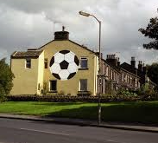

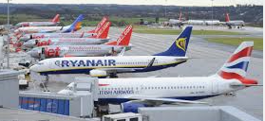
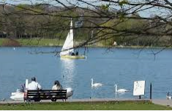

Year 1 Autumn term
Our local area
Geographical Skills & Fieldwork
Use a plan of the classroom to locate objects
Record information on a plan of the school
Record information on a plan of the local area
Make a simple map
Use the terms forwards,
backward, right turn, left turn, North, South East, West to navigate around a living map.
Use ipads and laptops to locate the area on google earth
Locational knowledge
Identify and describe what places are like
Identify and say where places are
Ask questions to find out about places
Use the terms forwards, backward, right turn, left turn, North, South East, West.
Begin to recognise how places have become the way they are and how they are changing.
Place Knowledge
The children will begin to recognise the features of the town of Yeadon. They will learn about specific landmarks such as the tarn and the airport.
Children will build models of those and other landmarks and position them on a living map. Children will use knowledge of position and direction to navigate themselves around the living map of Yeadon before drawing their own simple maps.

Slide 3

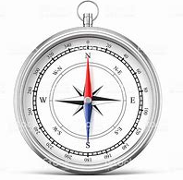
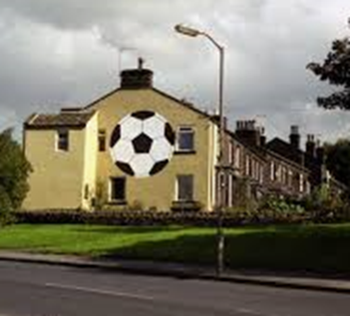
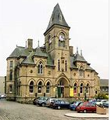


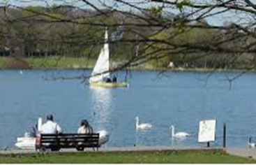
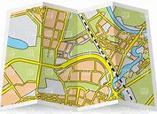
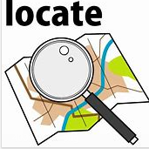

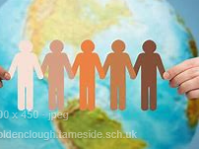
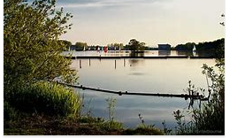
Vocabulary
Compass North, south, east, west
Houses
Football Town hall
Morrison’s
The tarn Airport
Locate Map
Human
Physical
Human Geographical Features
Town hall
Leeds Bradford Airport
Park
Morrison’s Supermarket
Yeadon high street
Football
The Steep (off high street)
Houses
Terrace
School
shops
Physical Geographical Features
The tarn
Hill
Field

Slide 4
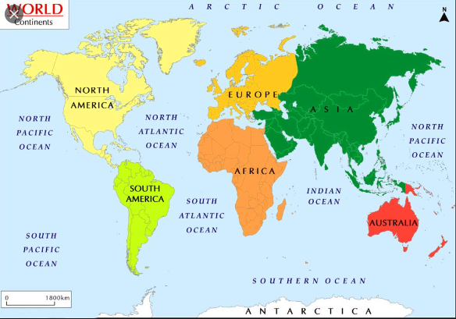
Year 1 Spring term
Continents and Oceans
Locational knowledge
Identify and describe where places are.
Identify and describe what places are like.
Know that continents are land and oceans are water.
Locate the British Isles.
Describe some key features of a place.
Ask questions to find out about places
Geographical skills
Use a map to locate land and sea.
Identify the equator and where hot and cold continents are.
Identify continents and oceans on a globe, an atlas and on a map of the world.
Label continents and oceans on a map of the world.
Use a key on a map.
Use a map to create a journey line.
Place Knowledge
The children will learn the names of the seven continents and five oceans and understand where to locate them on a map of the world. They will begin to understand the location of hot and cold areas of the world and to understand how a journey can be made around the world.

Slide 5

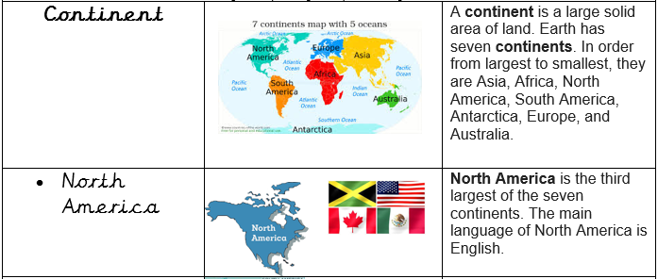
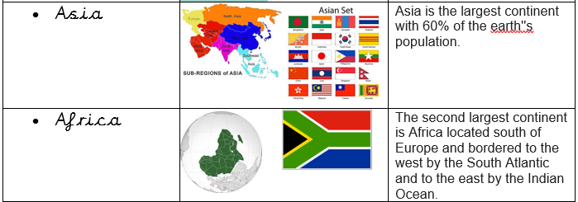
Physical Geographical Features
Continent jungle
Ocean desert
Sea iceberg
Island
Land
Equator
North pole
South pole
Climate
Human Geographical Features
Population
Country
Town
City
Village
Vocabulary

Slide 6

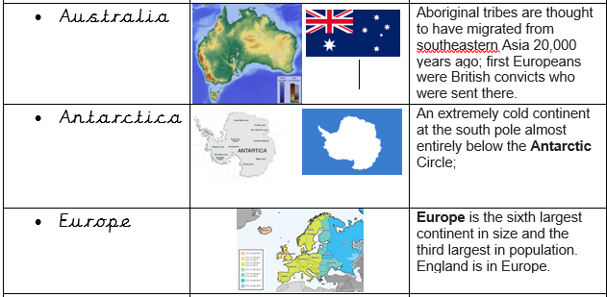
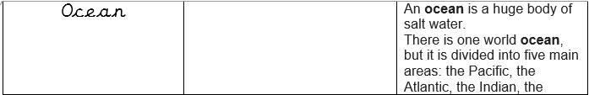
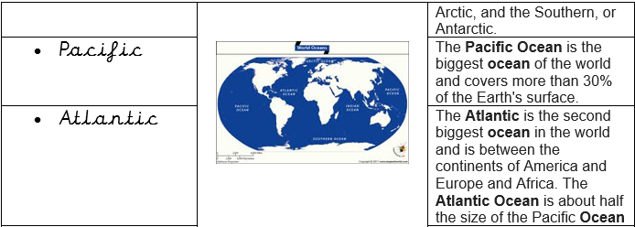
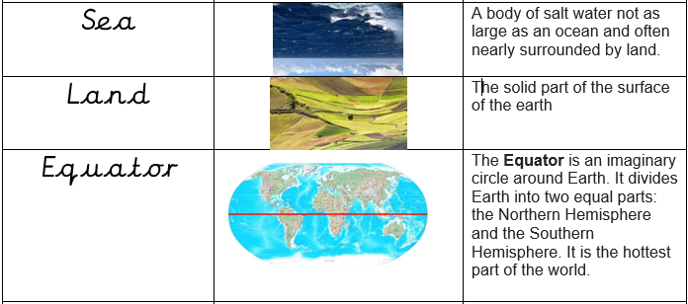
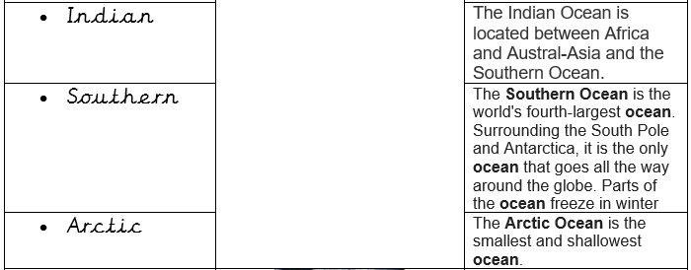
Vocabulary continued

Slide 7
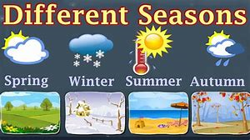
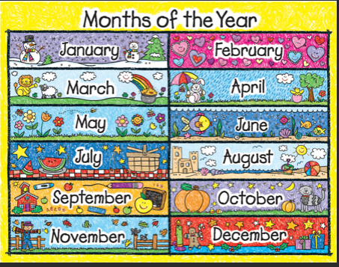
Year 1 Summer term
Seasonal weather patterns
Geographical skills
Explain how countries have different climates which can be hot or cold.
Recognise and name types of weather that happen in the UK.
Explain some ways the weather affects us in the clothes we wear, how we travel and the things we do.
Record weather over a given time
Use weather symbols to describe and forecast weather.
Record observations
Vocabulary
Weather
Uk
Temperature
Thermometer
Wind
Rain
Sun
Cloud
Seasons
Change
Affect
Spring
Summer
Autumn
Winter
Forecast
Observe
Record
Cool
Hot
Sunscreen
Hurricane
Flood
Blizzard
Heatwave
Protect
Knowledge
The children will build on from the work that they have covered in Science to understand the seasons of the year. They will learn to identify seasonal weather patterns in the context of the UK. They will begin to understand why forecasting the weather is important and how weather can impact on people’s lives in the UK.

Slide 8
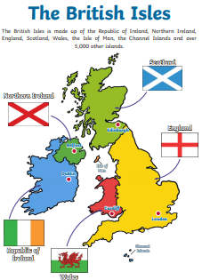
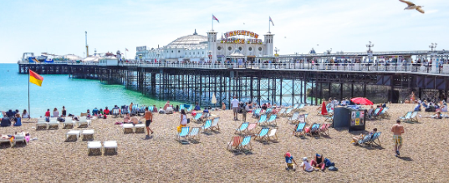
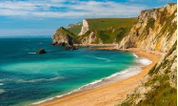
Year 2 Spring Term
Beaches
Geographical skills
Use maps and atlases to find and label the continents and oceans of the world
Use atlases and maps to find and label the countries, capital cities and seas of the UK
Describe each part of the beach and what people use them for
Identify which parts of the beach are human and physical geography
Place Knowledge
Know that beaches are found on the coast – the edge of the land before the sea
Know what a beach is and what we use them for
Identify the key features – the sand dunes, cliffs, pier, harbour and bay
Locational Knowledge
Name the 4 countries of the UK and their position on a map
Name the capital cities of the UK
Name the seas surrounding the UK
Name and describe the parts of a beach
Know what people use each part of the beach for
Know which parts are man-made and which are natural

Slide 9

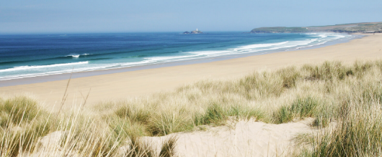
Year 2 Spring Term
Beaches
Physical Geography
UK
The names and locations of the 4 countries of the UK
The names of the Capital Cities in the UK
The names and locations of some of the larger seaside towns in the UK
Name the seas surrounding the UK
Beaches
On images of beaches, locate cliffs, sand dunes, bay and coast
Describe the main features of each of these parts of the beach
Human Geography
Beaches
On images of beaches, locate the pier, harbour, port, promenade and lighthouse
Describe the main features of each of these parts of the beach
Understand what each of these man-made parts of the beach are used for why they were built
Understand why people visit the beach and how tourism impacts on the beach and the people who live in the seaside towns
Vocabulary
Beach
Pier
Cliff
Bay
Harbour
Port
Sand dunes
Sand
Pebbles
Promenade
Beach hut
Lighthouse
Coast
Capital City
UK
England
Wales
Scotland
Northern Ireland

Slide 10
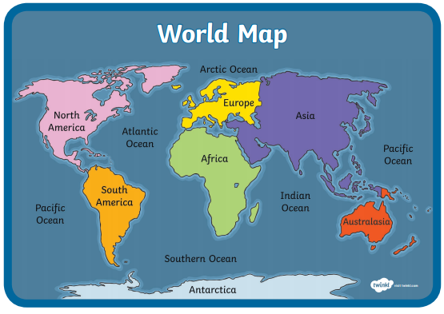
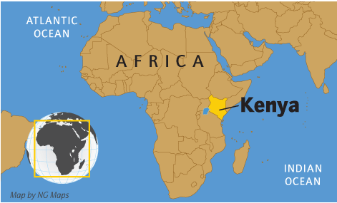
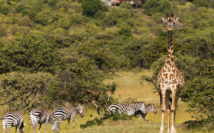
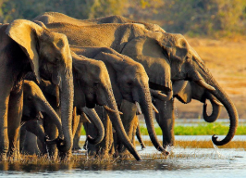

Year 2 Summer Term
Kenyan Safari
Geographical skills
Use maps and atlases to find and label the continents and oceans of the world
Use atlases and maps to find and label main arts of Kenya
Describe what Kenyan villages are like and compare them to a UK area (Yeadon)
Use compass directions to describe the location of places in Africa
Place Knowledge
Know some facts about the Masai people
Know how a Masai village is different to Yeadon
Know that Kenya is close to the equator and that this makes it very hot there
Lots of endangered animals live in Kenya – lions, elephants and giraffes
Locational Knowledge
Review the names the 4 countries of the UK and their position on a map
Review the names and locations of the continents and oceans
Know that Kenya is an African country
Know how we could get to Kenya, including compass directions

Slide 11
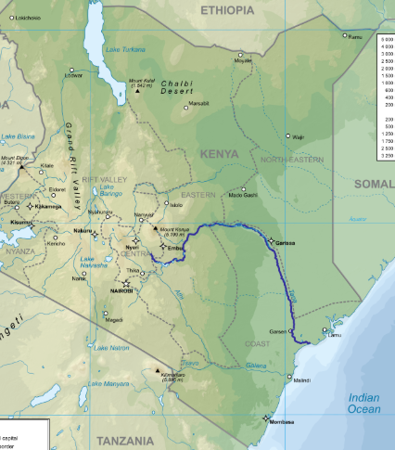
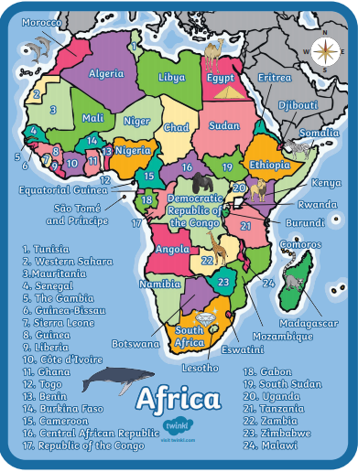
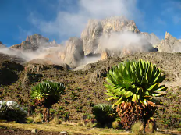
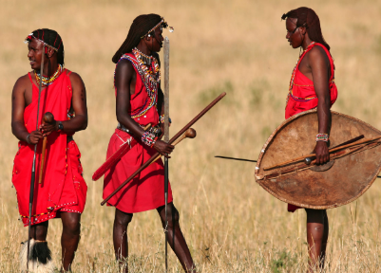
Vocabulary
Continent
Africa
Village
Town
City
Equator
Compare
Culture
Masai
Masai Mara
Desert
Year 2 Summer Term
Kenyan Safari
Plain
Savannah
Habitat
Game reserve
Endangered
Extinct
Migrate
National Park
Safari
Tribe
Nomadic
Human Geography
The population of Kenya is 45,010,056
Kenya has a mixture of people who live in big cities and tribal people
Lots of people visit Kenya every year on safari to see wild animals
Some people in Kenya are very rich and some are very poor
Lots of children in Kenya don’t go to school
Physical Geography
Kenya is located in East Africa.
The capital city of Kenya is Nairobi
Kenya has very mixed terrain (land types)
Know that Mount Kenya is the tallest mountain in Kenya
Know that the Tana is the longest river
Know that Kenya is has a long coast on the Indian Ocean
Tana River
Mount Kenya

Slide 12
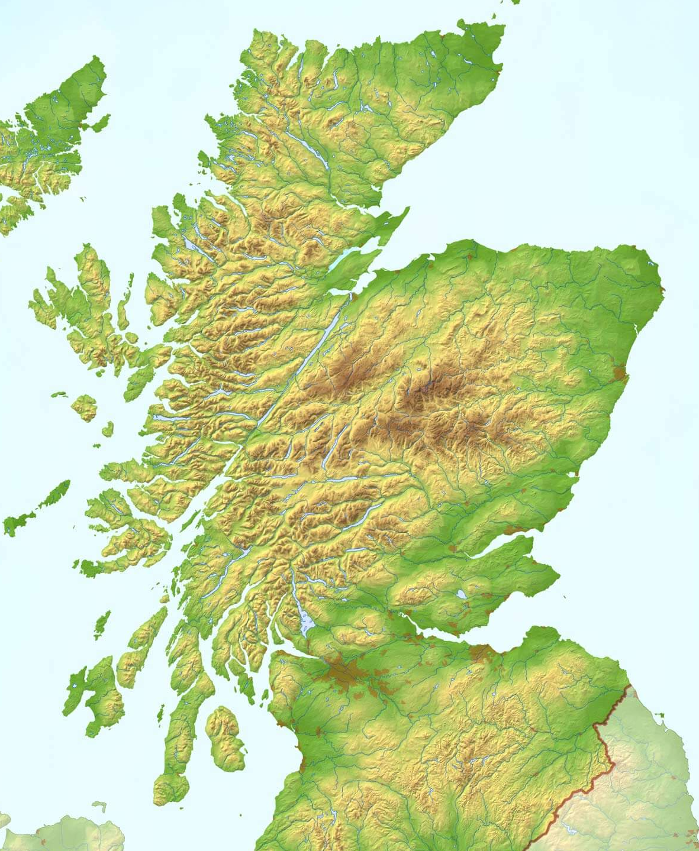
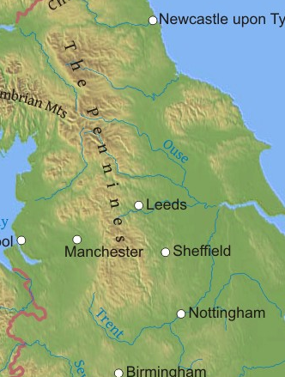
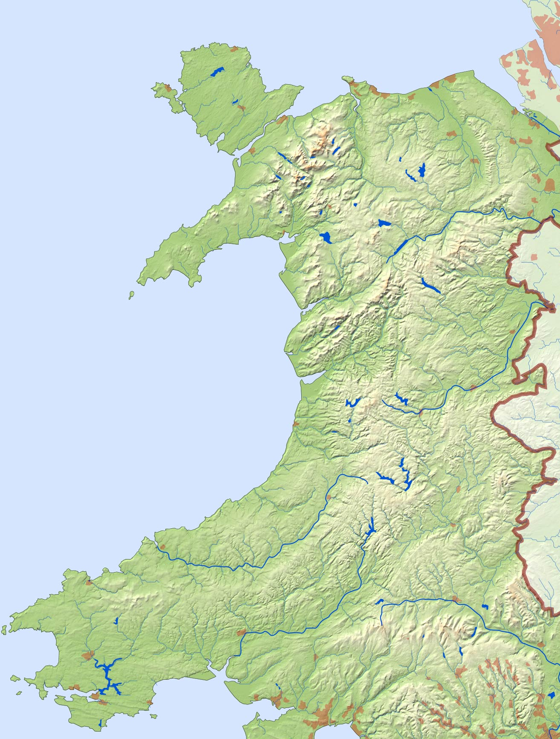
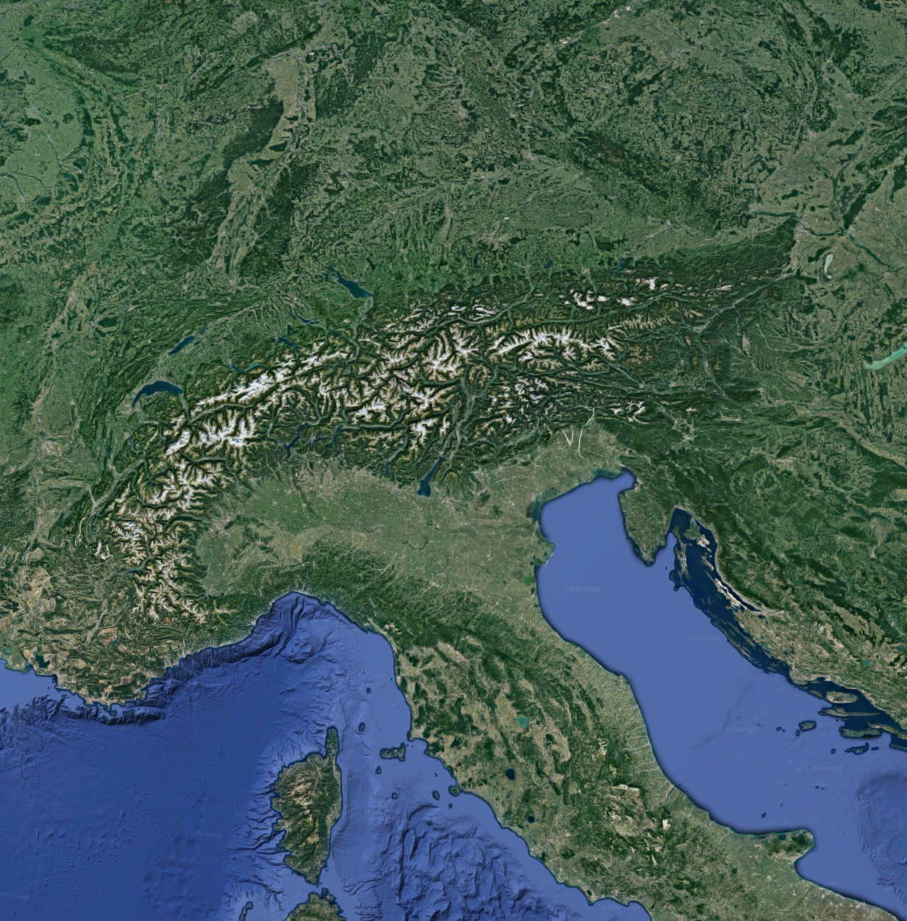
Year 3 Spring Term The UK/Mountains
Locational Knowledge
The children will name and locate counties and cities of the United Kingdom, geographical regions and their identifying human and physical characteristics, key topographical features (including hills, mountains, coasts and rivers).
Geographical Skills & Fieldwork
Use maps, atlases, globes and digital/computer mapping to locate countries and describe features studied
Use the eight points of a compass and symbols and keys (including the use of Ordnance Survey maps) to build knowledge of the United Kingdom
Use fieldwork to observe, measure, record and present the human and physical features in the local area using a range of methods, including sketch maps, plans and graphs, and digital technologies
Place Knowledge
Children will understand geographical similarities and differences through the study of physical geography of a mountainous region of the United Kingdom and a mountainous region within Europe.
Scottish Highlands
The Pennines
Snowdonia, Cambrian Mtns & Brecon Beacons
The French, Italian, Austrian and Swiss Alps

Slide 13
Year 3 Spring Term The UK/Mountains
Physical Geographical Features
The UK
Location of major cities – London, Edinburgh, Cardiff and Belfast
The Thames, the Aire
The North Sea, the English Channel, the Irish Sea, the Atlantic Ocean
Mountains
Find the height of a mountain on a map
Locate mountain ranges on a physical map
The Scottish Highlands
Snowdonia
The Pennines
The Lake District
Ben Nevis
Snowdon
Scafell Pike
The Alps
Mont Blanc
Human Geographical Features
The UK
The countries that make up the UK
Capital Cities of the countries of the UK – name and label them on a map.
Name the seas surrounding the UK and name some of the main rivers
Know what a county is and find West Yorkshire on a map
Find London on UK and main maps
Describe how the UK population has changed over time
Use 8 compass directions to find a location on a map
Mountains
Know the names of the highest peaks in Scotland, Wales and England and the closest mountains to Yeadon
Compare mountains of the UK to those in Continental Europe
Know different types of mountains and how they are formed
Key Vocabulary
Country
UK
England
Wales
Scotland
Northern Ireland
The Republic of Ireland
County
Yorkshire
Sea
Ocean
River
Mountain
Range
Highlands
Ben Nevis
Snowdonia
Snowdon
The Pennines
The Lake District
Scafell Pike
Europe
The Alps
Mont Blanc

Slide 14
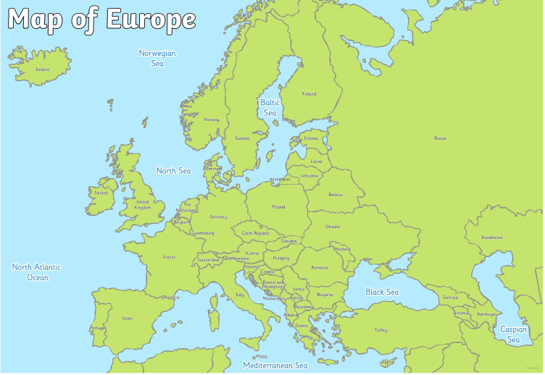
Year 4 Spring Term
Europe/ Rivers
Locational Knowledge
The children will locate, using maps, the countries and major cities of Europe (including the location of Russia) concentrating on their environmental regions and key physical and human characteristics including hills, mountains, coasts and identifying volcanoes/ earthquakes in Europe.
Geographical Skills & Fieldwork
Use maps, atlases, globes and digital/computer mapping to locate countries and describe features studied
Use the eight points of a compass and symbols and keys (including the use of Ordnance Survey maps) to build knowledge of the wider world
Use fieldwork to observe, measure, record and present the human and physical features in the local area using a range of methods, including sketch maps, plans and graphs, and digital technologies
Place Knowledge
Children will understand geographical similarities and differences through the study of physical geography of a river that passes through Leeds (River Aire) and comparing it to a river in Europe.
Knowledge
The children will learn about the water cycle and connect this learning to their knowledge of rivers.

Slide 15
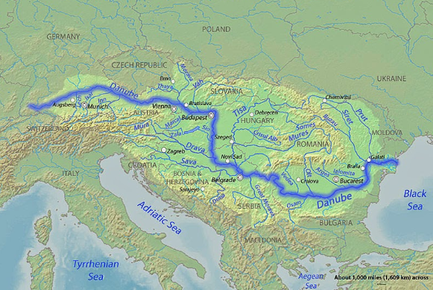
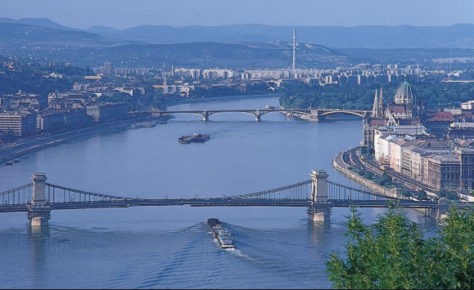
Year 4 Spring Term
Europe/ Rivers
Physical Geographical Features
Locate and compare the River Aire in the UK to the Danube River in Europe.
Understand how rivers are formed and it’s journey from source to mouth and other parts of a river such as tributaries, meanders and river delta.
River erosion and deposition.
Locate major rivers in Europe ( Rhine River, Seine, Volga River) and compare the physical geography to rivers in the UK (River Aire, River Thames, River Ouse).
Locate coasts, mountains (Mont Blanc, Matterhorn, Mount Elbrus, Monte Rosa, Dolomites, Mount Olympus), volcanoes (Mt Etna, Mt Vesuvius, Hekla, Teide) in Europe.
Describe and understand key aspects of the Water Cycle including evaporation, precipitation, condensation and collection.
Key Vocabulary
Europe
Rivers
Mouth
Source
course
Channel
Confluence
Delta
estuary
Floodplain
levee
Meander
oxbow lake
waterfall.
Natural resources
Tourism
Economic activity
Trade Links
Water cycle
Evaporation condensation precipitation
Collection
Sea
Ocean
Currency
Language
Human Geographical Features
Rivers
Types of settlement and land use.
Economic activity including trade links.
The distribution of natural resources.
River pollution
A comparison study of a European town (which borders the River Danube) and Yeadon
Europe
Recap what a country is and understand what a continent is.
Facts about Europe as a whole such as it’s size, population and smallest and largest countries.
The countries and major cities that make up Europe (locate and label)
The seas and oceans that surround Europe (recap learning on UK from Year 3)
Features of European countries (flags, languages, currency, monarchy/parliament)

Slide 16
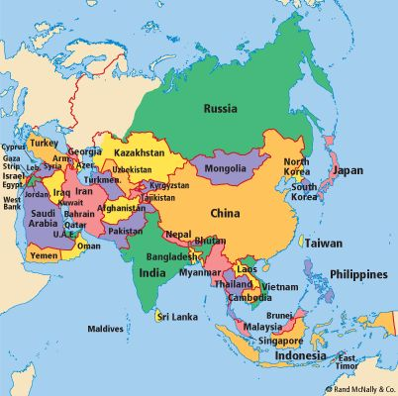
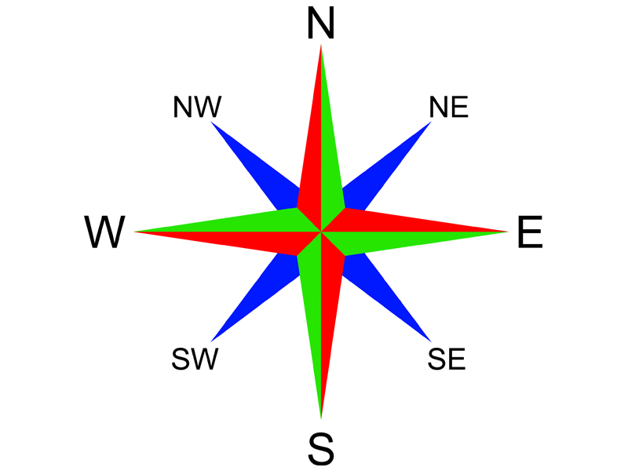
Year 5 Spring Term Asia
Locational Knowledge
The children will locate, using maps, the countries and major cities of Asia concentrating on their environmental regions and key physical and human characteristics.
They will also learn to identify the Prime/Greenwich Meridian and time zones within Asia.
Geographical Skills & Fieldwork
Use maps, atlases, globes and digital/computer mapping to locate countries and describe features studied
Use the eight points of a compass and symbols and keys (including the use of Ordnance Survey maps) to build knowledge of the wider world
Use fieldwork to observe, measure, record and present the human and physical features in the local area using a range of methods, including sketch maps, plans and graphs, and digital technologies
Place Knowledge
The children will discover and show an understanding of geographical similarities and differences through a study of the human and physical geography of Yeadon comparing it to a village in India – Chembakolli.

Slide 17
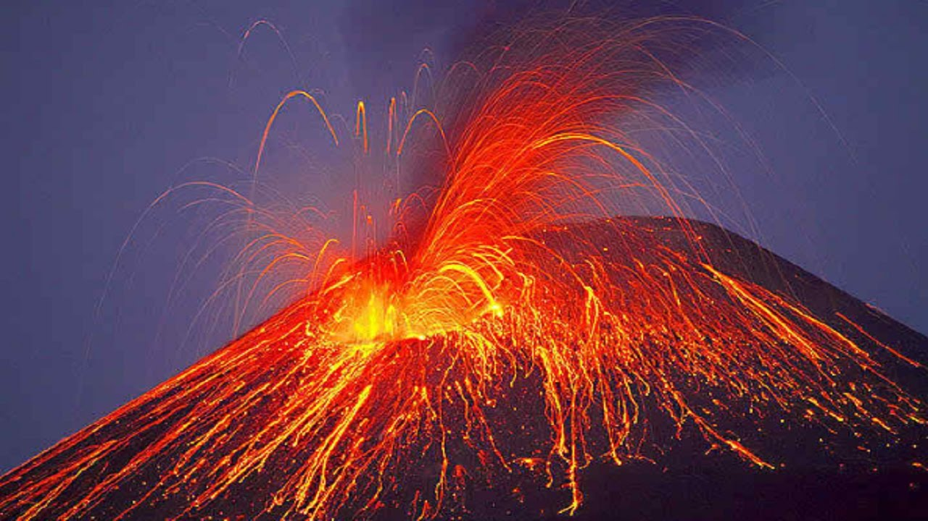
Year 5 Spring Term Asia
Physical Geographical Features
The Rocky mountains
The Himalayan Mountain Range
Mount Everest
The Gobi Desert
Tien Shan Mountains
Ural Mountains
Yangtze River
Lake Baikal
Bay of Bengal
West Siberian Plain
Tibetan Plateau – ‘Rooftop of the World’
Asia- climate zones and biomes (deserts, temperate grasslands, coniferous forests, tropical rainforests, tundra and mountains)
Asian volcanoes and earthquakes
Population
Oceans - Asia is bounded by the Arctic Ocean to the north, the Pacific Ocean to the east, the Indian Ocean to the south,
Key Vocabulary
Continent
Asia
Climate
Climate Zones
Biomes
Human & Physical Geography
Population
Land use
Settlements
Prime/Greenwich Meridian
Time Zones
Natural resources
Tourism
Economic activity
Trade Links
Volcano
Earthquake
Crust
Mantle
Outer core
Inner Core
Tectonic Plates
Active
Dormant
Extinct
Human Geographical Features
Asia
The Layers of the earth
How volcanoes are formed/how they affect peoples lives
Settlements in Asia
What causes earthquakes and how they are measured
Natural resources from Asia (silver, gas, coal, rice etc.)
Tourism from Asia
Economic activity, including trade links to and from Asia

Slide 18
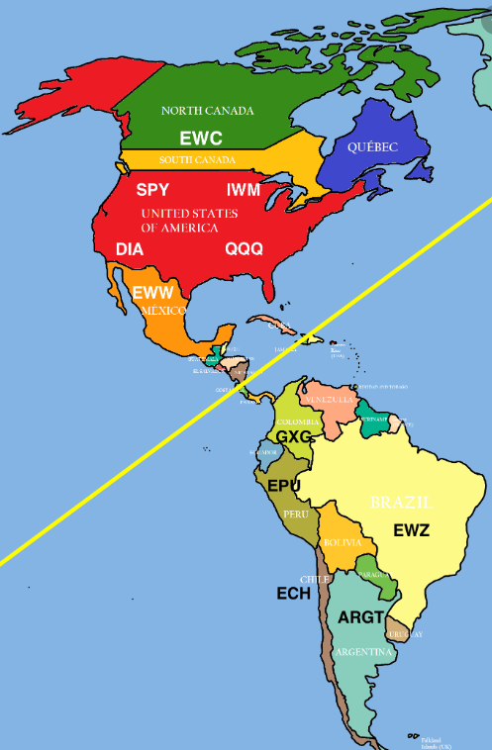
Year 6 Spring Term The Americas
Locational Knowledge
The children will locate, using maps, the countries and major cities of North and South America, concentrating on their environmental regions and key physical and human characteristics.
They will also learn to identify the position and significance of latitude, longitude, Equator, Northern Hemisphere, Southern Hemisphere, the Tropics of Cancer and Capricorn, Arctic and Antarctic Circle, the Prime/Greenwich Meridian and time zones.
Geographical Skills & Fieldwork
Use maps, atlases, globes and digital/computer mapping to locate countries and describe features studied
Use the eight points of a compass, four and six-figure grid references, symbols and key (including the use of Ordnance Survey maps) to build knowledge of the wider world
Use fieldwork to observe, measure, record and present the human and physical features in the local area using a range of methods, including sketch maps, plans and graphs, and digital technologies
Place Knowledge
The children will discover and show an understanding of geographical similarities and differences through a study of the human and physical geography of Yeadon comparing it with a region of North and specifically to Brazil in South America.

Slide 19
Year 6 Spring Term The Americas
Physical Geographical Features
NORTH AMERICA
The Rocky mountains (mountain range)
The Grand Canyon (carved out of the rock by the Colorado River through the process of erosion)
The Niagara Falls (waterfalls)
Hubbard Glacier, Alaska
Death Valley (Mojave Desert)
Rincon Beach (Samana peninsula in the Dominican Republic)
Population
SOUTH AMERICA
The Amazon Rainforest - climate zones, biomes, vegetation belts
The Amazon River
Kilauea volcano in Hawaii
The Atacama Desert
The Andes Mountain Range
Volcano zones in the Andes
Population
Key Vocabulary
Continent
North & South America
Climate
Climate Zones
Human & Physical Geography
Population
Land use
Settlements
Rainforest
Tropics
Cancer
Capricorn
Equator
Arctic Circle
Latitude/Longitude
Prime/Greenwich Meridian
Time Zones
Biomes
Vegetation Belt
Natural resources
Tourism
Economic activity
Human Geographical Features
NORTH AMERICA
The Panama Canal - linking the Atlantic and Pacific Oceans
Hoover Dam (creating hydroelectric power)
SOUTH AMERICA
Settlements in the Andes
Natural resources from the Andes (gold, silver, gas, coal etc.)
Hydroelectric dams in the Andes(energy from flowing water harnessed as electricity)
Tourism from the Andes
Economic activity, including trade links to and from South America

Slide 20
Themes:
The British Isles
Y1 – Continents & Oceans (Spring term)
Locate the British Isles
Y2 – Beaches (Spring term)
Name the 4 countries of the UK and their position on a map
Name the capital cities of the UK
Name the seas surrounding the UK
Use atlases and maps to find and label the countries, capital cities and seas of the UK
Y2 – Kenyan Safari (Summer term)
Review the names the 4 countries of the UK and their position on a map
Y3 – The UK (Spring term)
Name and locate counties and cities of the United Kingdom, geographical regions and their identifying human and physical characteristics, key topographical features (including hills, mountains, coasts and rivers)
Human Features:
The countries that make up the UK, capital Cities of the countries of the UK – name and label them on a map, name the seas surrounding the UK and name some of the main rivers, know what a county is and find West Yorkshire on a map, find London on UK and main maps, describe how the UK population has changed over time
Physical Features:
Location of major cities – London, Edinburgh, Cardiff and Belfast, the Thames, the Aire, the North Sea, the English Channel, the Irish Sea, the Atlantic Ocean
Y4 – Europe (Spring term)
Recap learning on the UK – continent, country, major cities, seas and Oceans
Locate and compare the River Aire in the UK to the Danube River in Europe
Y5 – Asia (Spring term)
Human and physical geography of Yeadon compared to a village in India – Chembakolli
Y6 – The Americas (Spring term)
Human and physical geography of Yeadon compared to a region of North America and specifically to Brazil in South America
Studying Yeadon
Y1 – Our Local Area (Autumn term)
Human and Physical features of Yeadon
Y2 – Kenyan Safari (Summer term)
Describe what Kenyan villages are like and compare them to Yeadon
Y4 – Europe (Spring term)
A comparison study of a European town (which borders the River Danube) and Yeadon
Y5 – Asia (Spring term)
Human and physical geography of Yeadon compared to a village in India – Chembakolli
Y6 – The Americas (Spring term)
Human and physical geography of Yeadon compared to a region of North America and specifically to Brazil in South America

Slide 21
Themes:
Continents & Oceans
Y1 – Continents & Oceans (Spring term)
Name the seven continents and five oceans and locate them on a map of the world
Y2 – Beaches (Spring term)
Use maps and atlases to find and label the continents and oceans of the world
Y2 – Kenyan Safari (Summer term)
Review the names and locations of the continents and oceans
Know that Kenya is located in Africa
Know that Kenya is has a long coast on the Indian Ocean
Y3 – The UK (Spring term)
Know that the UK is part of Europe
Locate, using maps, the major cities of the UK
Physical features of the UK – the Atlantic Ocean
Y4 – Europe (Spring term)
Locate, using maps, the countries and major cities of Europe (including the location of Russia)
Recap understanding of a continent
The countries and major cities that make up Europe (locate and label)
The seas and oceans that surround Europe
Y5 – Asia (Spring term)
Locate, using maps, the countries and major cities of Asia
Asia is bounded by the Arctic Ocean to the north, the Pacific Ocean to the east, the Indian Ocean to the south,
Y6 – The Americas (Spring term)
Locate, using maps, the countries and major cities of North and South America
The Panama Canal - linking the Atlantic and Pacific Oceans
The Equator
Y1 – Continents & Oceans (Spring term)
Identify the equator and where hot and cold continents are. Learn that the Equator is an imaginary circle around the Earth dividing it in two parts: the Northern and Southern Hemisphere. It is the hottest part of the world.
Y2 – Kenyan Safari (Summer term)
Know that Kenya is close to the equator and that this makes it very hot there
Y6 – The Americas (Spring term)
identify the position and significance of latitude, longitude, Equator, Northern Hemisphere, Southern Hemisphere, the Tropics of Cancer and Capricorn, Arctic and Antarctic Circle

Slide 22
Themes:
Mountains
Y2 – Kenyan Safari (Summer term)
Know that Mount Kenya is the tallest Mountain in Kenya
Y3 – The UK – Mountains (Spring term)
Know different types of mountains and how they are formed
The study of physical geography of a mountainous region of the United Kingdom and a mountainous region within Europe
Know the names of the highest peaks in Scotland, Wales and England and the closest mountains to Yeadon (The Scottish Highlands, Snowdonia, The Pennines, The Lake District, Ben Nevis, Snowdon, Scafell Pike, The Alps, Mont Blanc)
Compare mountains of the UK to those in continental Europe (The French, Italian, Austrian and Swiss Alps)
Y4 – Europe – Rivers (Spring term)
Mountains in Europe (Mont Blanc, Matterhorn, Mount Elbrus, Monte Rosa, Dolomites, Mount Olympus)
Y5 – Asia (Spring term)
Mountains in Asia (The Rocky mountains, The Himalayan Mountain Range, Mount Everest, Tien Shan Mountains, Ural Mountains, Tibetan Plateau – ‘Rooftop of the World’)
Y6 – The Americas (Spring term)
Mountains in America (The Rocky Mountains, The Andes Mountain Range)
Rivers
Y2 – Kenyan Safari (Summer term)
Know that the Tana is the longest river in Kenya
Y3 – The UK – Mountains (Spring term)
Name some of the main UK rivers (e.g. The Thames, the Aire)
Y4 – Europe – Rivers (Spring term)
Locate and compare the River Aire in the UK to the Danube River in Europe.
Understand how rivers are formed and it’s journey from source to mouth and other parts of a river such as tributaries, meanders and river delta.
River erosion and deposition.
Locate major rivers in Europe ( Rhine River, Seine, Volga River) and compare the physical geography to rivers in the UK (River Aire, River Thames, River Ouse).
Y5 – Asia (Spring term)
Locate the Yangtze River
Y6 – The Americas (Spring term)
Physical Geography of North America: The Grand Canyon (carved out of the rock by the Colorado River through the process of erosion)
Physical Geography of South America: The Amazon Rainforest

Slide 23
Themes:
Natural Disasters: Volcanoes & Earthquakes
Y4 – Europe – Rivers (Spring term)
Locate volcanoes (Mt Etna, Mt Vesuvius, Hekla, Teide) in Europe
Y5 – Asia (Spring term)
The Layers of the earth
How volcanoes are formed/how they affect peoples lives
What causes earthquakes and how they are measured
Asian Volcanoes & Earthquakes
Y6 – The Americas (Spring term)
South America:
Volcano zones in the Andes
Kilauea volcano in Hawaii

