Slide 1
SCIENCE – Year 4
Knowledge organisers

Slide 2
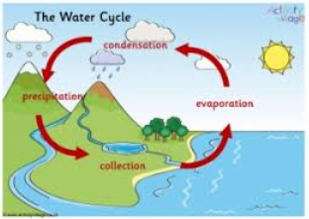
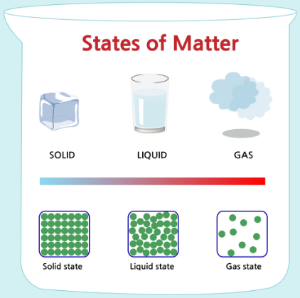
Year 4 Autumn Term 1
States of Matter
Key Questions
Does temperature effect states of matter
Identify some solids, liquids and gases?
What is the water cycle?
Explain condensation/evaporation?
Key Vocabulary
Solid
Liquid
Gas
Properties
Temperature
Precipitation
Collection
Condensation
Evaporation
Water cycle
Changing
State
Water
Wind
Sun
Rain
Sea
River
Stream
Puddle
Overview
Children will learn about the differences between solids, liquids and gases, classifying objects and identifying their properties. The children will work scientifically and collaboratively to investigate the weight of a gas. Furthermore, they will have chance to find the ideal temperature to melt chocolate. They will explore in-depth how water changes state, exploring melting, freezing, condensing as well as a particular focus on evaporation. Finally, they will learn about the stages of the water cycle, create a mini water world and write a report.

Slide 3
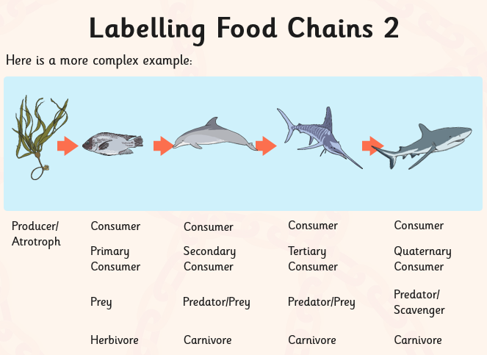
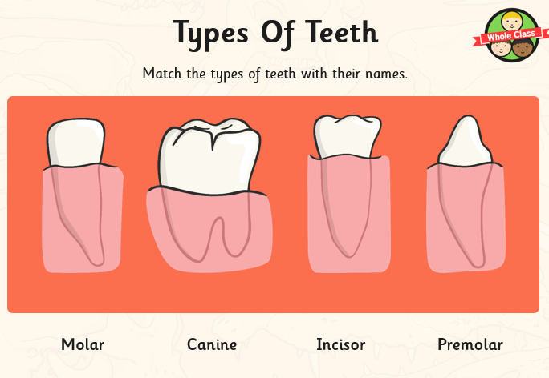
Year 4 Autumn Term 2
Animals including Humans 1 (Teeth/ Producers, predators and prey)
Key Vocabulary
Teeth
Canine
Molar
Premolar
Incisor
Tongue
Gums
Healthy
Sugar
Additives
Calcium
Food chain
Producer
Predator
Prey
Source
Overview
The children will learn about the different functions of teeth in humans and animals. They will get to experience the job of a dentist and will learn about the ways to keep their teeth healthy and the effects that different foods have on our teeth. They will learn more about herbivores, carnivores and omnivores in the context of teeth and the food chain. In addition, they will extend their understanding of food chains to more complex chains and food webs.
Key Questions
What are the basic functions of our teeth?
Can you name the different teeth?
What is a producer/predator/prey?
How can we keep our teeth healthy?
What is a food chain?
Can you create a complex food chain?

Slide 4
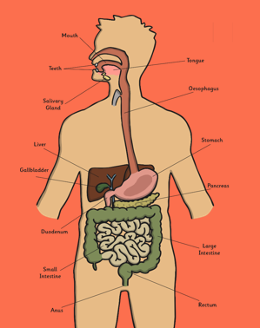
Year 4 Spring Term 1
Animals including Humans 2 (Body parts and their functions)
Key Vocabulary
Digestive system
Digestion
digest
Mouth
Tongue
Teeth
Oesophagus
Stomach
Liver
Duodenum
Pancreas
Liver
Salivary glands
gallbladder
Ileum
Small intestine
Colon
Large intestine
Rectum
Anus
Overview
The children will learn about the basic parts of the digestive system and their functions. They will work collaboratively to research and investigate how the digestive system works in humans and animals. They will link this learning to the functions of the mouth and teeth. They will look at how to keep their bodies healthy and sort foods based on the sugar or fat content.
Key Questions
What are the basic parts of the digestive system and their functions?
How can we keep our bodies healthy?
Is there a difference between the digestive systems of humans and animals?

Slide 5
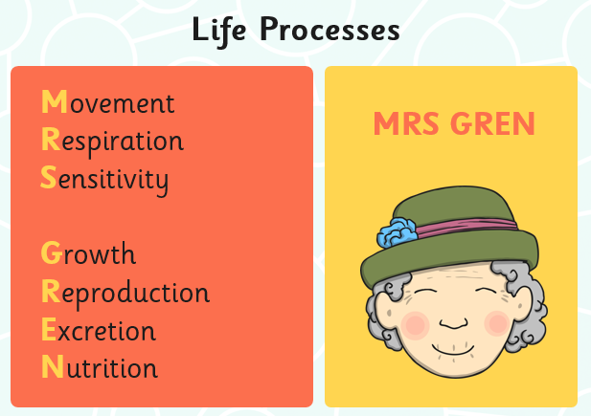
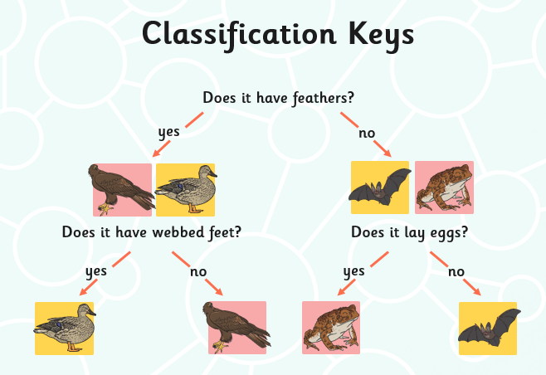
Year 4 Spring Term 2 Living things and their habitat
Key Vocabulary
Amphibian
Bird
Characteristic
Classification
Conservation
Endangered
Environment
Extinct
Fish
Global
Habitat
Invertebrates
Key
Local
Mammal
Organism
Reptile
Variation
Wildlife
Overview
The children will explore a variety of different ways to sort, group and classify living things. They will learn how animals are split into vertebrates and invertebrates and begin to consider the differences between living things within these classifications. They will use and create classification keys to group, identify and name living things form the local habitat and beyond. The children will also learn and discuss the significant impact that man made and natural changes can have on living things.
Key Questions
What are the seven life processes?
How can we classify living things?
How can we use a classification key?
How could changes to the environment endanger living things?

Slide 6
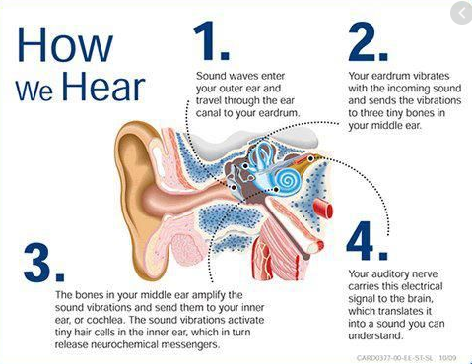

Year 4 Summer Term 1 Sound
Key Vocabulary
Sound
noise
pitch
volume
vibrations
loud
quiet
high
low
decibels
noise pollution
distance
travel
absorbs
ear
Key Questions
How are sounds made?
How do we hear sounds?
What makes sounds louder or quieter?
What makes sounds higher or lower?
What does the word pitch mean?
What does the word volume mean?
Overview
The children will learn about how vibrations cause sounds and how sounds travel, as well as how sounds can change pitch and volume. They will also learn about how sounds are made, carrying out demonstrations of vibrations, and completing a sound survey of their school. The children will work in a hands-on way to explore pitch. They will have the opportunity to make a string telephone, and will use this to investigate how sounds change over distance and through different materials. The children will work scientifically and collaboratively to investigate the best material for soundproofing, in the context of making a music studio quieter.

Slide 7
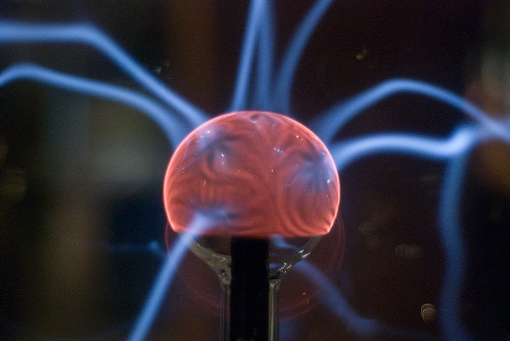
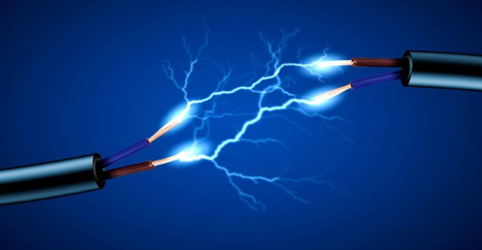
Year 4 Summer Term 2
Electricity
Key Vocabulary
Electric
Electrical
Electricity
Appliance
Conductor
Insulator
Circuit
Switch
Mains
Battery
Materials
Conduct
Wires
Lightning
Renewable
Non-renewable
generate
Overview
Children will learn about what electricity is and how it was discovered. They will identify which appliances use electricity in their homes and how to keep themselves safe. Children will construct circuits, start to create pictorial circuits and conduct an investigation into how easily different types of switches can break and reconnect a circuit.
They will put their knowledge of circuits on display by building their own circuit to create a buzz-wire game. Then, use their game to try to defeat a challenger.
Key Questions
What is electricity?
How does electricity travel?
What makes a good conductor?
How can we keep ourselves safe when using electricity?

