Slide 1
HISTORY – Year 4
Knowledge organisers

Slide 2
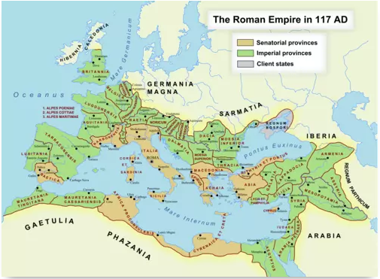
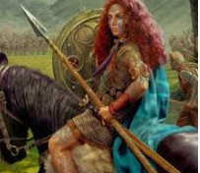
Year 4 Autumn Term
Romans
Historical skills
Know and understand significant aspects of history.
Create their own structured accounts – including written narratives and analyses.
Understanding how past events have shaped the world we know today.
Note connections, contrasts and trends over time.
Key Vocabulary
AD
BC
Celts
Century
Chariot
Consul
Conquer
Dictator
Economy
Emperor
Empire
Gladiator
Government
Legion
Senate
Overview
The children will learn when and how the Romans invaded Britain. They will learn about the battles that took place between the Romans and the Celts whilst the Romans were trying to build their empire. They will also learn what the Romans brought with them to the country and the influence/structures that are still present today.
Famous people studied
Boudicca
Emperor Nero
Emperor Julias Caesar
Boudicca

Slide 3
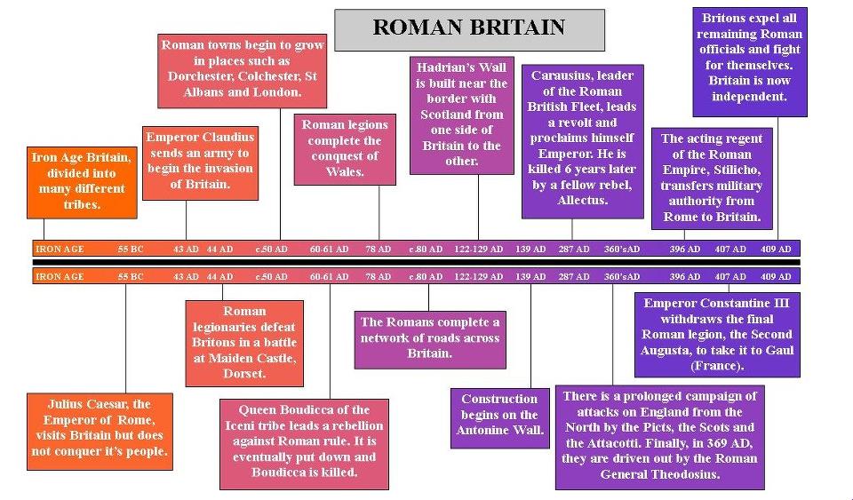

Slide 4
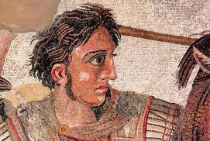
Year 4 Summer Term
Ancient Greece
Historical Skills
Know and understand significant aspects of history.
Note connections, contrasts and trends over time.
Understand our knowledge of the past is constructed from a range of sources
Create their own structured accounts – including written narratives and analyses.
Understand how our knowledge of the past is constructed from a range of sources.
Understand how evidence is used to make historical claims.
Key Vocabulary
Acropolis
Assembly
Democracy
Oligarchy
Olympics
Titans
Tyrant
Unit overview
The children will learn about who the Ancient Greek people were, when they lived and where and how they were able to establish their empire. They will learn how the political system worked, investigate the legacy of Athenian Democracy and compare it with the political systems we have today. The children will also compare and contrast the modern day Olympics with the Ancient Greek events and use their mathematical skills to present their findings. They will learn about, and order events from, the Battle of Marathon. We will also learn about Ancient Greek religion, research information about a variety of Greek gods and write their own Greek myth. Finally, they will use historical evidence to find out about the Trojan War and use the information to write and re-enact scenes from it.
Famous people studied
Alexander the Great
Pythagorus
Alexander the Great

Slide 5
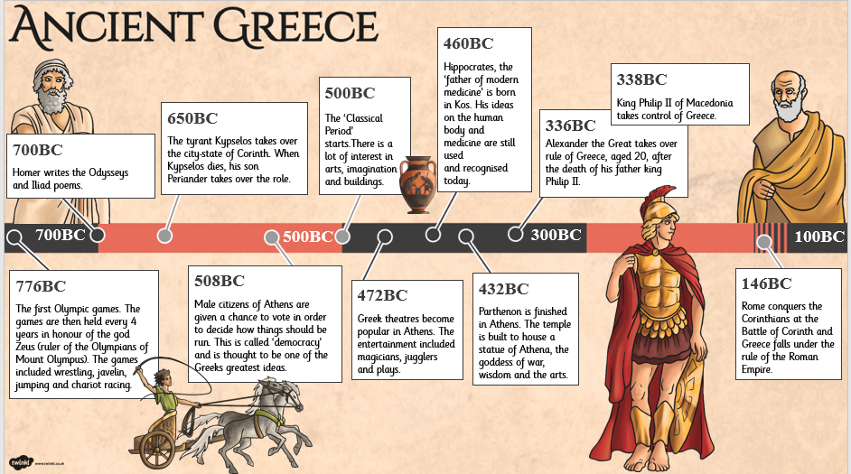
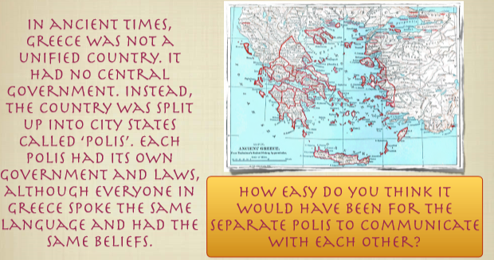
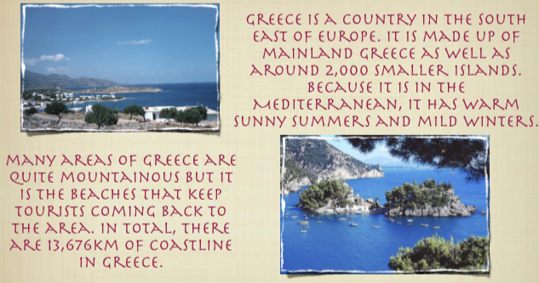
An extract from our Year 4 class text
Who let the Gods out?
Elliot’s mum is ill and his home is under threat, but a shooting star crashes to earth and changes his life forever. The star is Virgo—a young goddess on a mission. But the pair accidentally release Thanatos, a wicked death daemon imprisoned beneath Stonehenge, and must then turn to the old Olympian gods for help. After centuries of cushy retirement on earth, are Zeus and his crew up to the task of saving the world—and solving Elliot’s problems too?
Focus on Reading...

