Slide 1
GEOGRAPHY – Year 4
Knowledge organisers

Slide 2
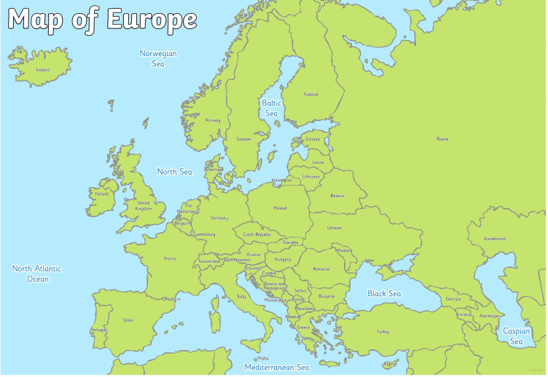
Year 4 Spring Term
Europe/ Rivers
Locational Knowledge
The children will locate, using maps, the countries and major cities of Europe (including the location of Russia) concentrating on their environmental regions and key physical and human characteristics including hills, mountains, coasts and identifying volcanoes/ earthquakes in Europe.
Geographical Skills & Fieldwork
Use maps, atlases, globes and digital/computer mapping to locate countries and describe features studied
Use the eight points of a compass and symbols and keys (including the use of Ordnance Survey maps) to build knowledge of the wider world
Use fieldwork to observe, measure, record and present the human and physical features in the local area using a range of methods, including sketch maps, plans and graphs, and digital technologies
Place Knowledge
Children will understand geographical similarities and differences through the study of physical geography of a river that passes through Leeds (River Aire) and comparing it to a river in Europe.
Knowledge
The children will learn about the water cycle and connect this learning to their knowledge of rivers.

Slide 3
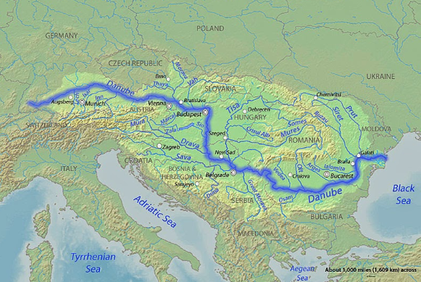
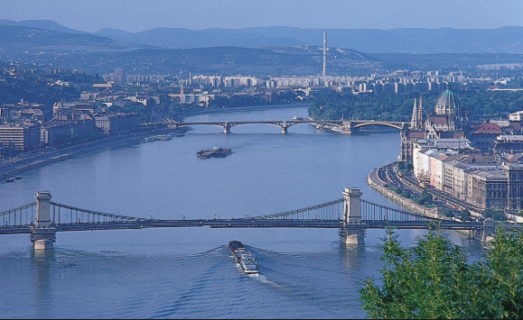
Year 4 Spring Term
Europe/ Rivers
Physical Geographical Features
Locate and compare the River Aire in the UK to the Danube River in Europe.
Understand how rivers are formed and it’s journey from source to mouth and other parts of a river such as tributaries, meanders and river delta.
River erosion and deposition.
Locate major rivers in Europe ( Rhine River, Seine, Volga River) and compare the physical geography to rivers in the UK (River Aire, River Thames, River Ouse).
Locate coasts, mountains (Mont Blanc, Matterhorn, Mount Elbrus, Monte Rosa, Dolomites, Mount Olympus), volcanoes (Mt Etna, Mt Vesuvius, Hekla, Teide) in Europe.
Describe and understand key aspects of the Water Cycle including evaporation, precipitation, condensation and collection.
Key Vocabulary
Europe
Rivers
Mouth
Source
course
Channel
Confluence
Delta
estuary
Floodplain
levee
Meander
oxbow lake
waterfall.
Natural resources
Tourism
Economic activity
Trade Links
Water cycle
Evaporation condensation precipitation
Collection
Sea
Ocean
Currency
Language
Human Geographical Features
Rivers
Types of settlement and land use.
Economic activity including trade links.
The distribution of natural resources.
River pollution
A comparison study of a European town (which borders the River Danube) and Yeadon
Europe
Recap what a country is and understand what a continent is.
Facts about Europe as a whole such as it’s size, population and smallest and largest countries.
The countries and major cities that make up Europe (locate and label)
The seas and oceans that surround Europe (recap learning on UK from Year 3)
Features of European countries (flags, languages, currency, monarchy/parliament)

