Slide 1
Art and Design – Year 4
Knowledge organisers

Slide 2
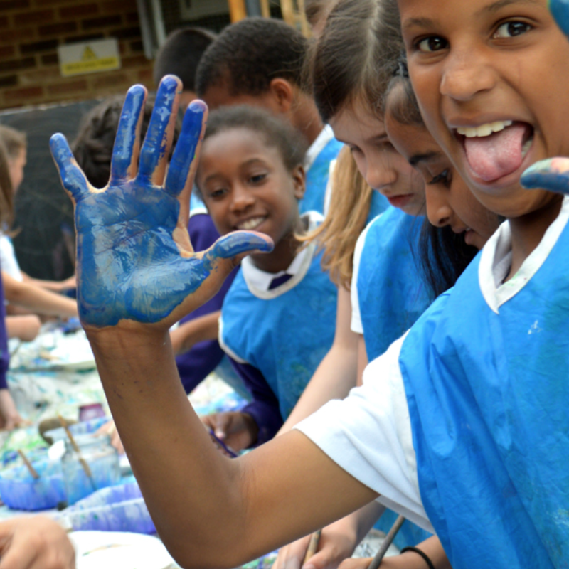
Art and Design Year 4:
Drawing
Prior Learning
Children have learned the techniques of line, shape, colour, texture, tone and space when drawing from observation or imagination.
Y4 Cross Curricular Links: ??
Exploring and Developing Ideas: (Look, Talk , Sketch, Research)
Build on the use of sketch books and research to inspire drawings from memory or imagination.
Key Learning
Children will begin to make informed choices in drawing about technique and media. They will continue to use sketchbooks to practice and develop their drawing skills: to explore colour and technique, to draw what is remembered, imagined and observed, to test and collect ideas.
Activities, Artists and Links
Autumn Term
Draw Roman Artefacts – wax and colour
Spring Term
Monet Inspired Drawings
Summer Term
Draw a mythical creature
Evaluating and Developing Work
Continue to discuss and share views about own and others work, including making suggestions.
Alter and refine drawings and describe changes using art vocabulary.
Key Skills
Begin to explore relationships between different elements eg line and tone, pattern and shape, line and texture.
Begin to layer media to investigate effect eg wax resist with coloured inks
Be able to draw in response to a wide range of stimuli.
Key Vocabulary
portrait, light, dark, tone, shadow, line, pattern, texture, form, shape, tone, outline
Knowledge and Understanding
Know and use correct vocabulary when discussing own, others and artists work.

Slide 3
Art and Design Year 4:
Painting
Prior Learning
Children have learned about colour, tone and scale. They have experimented with technique and texture.
Y4 Cross Curricular Links: Monet/ Rivers
Exploring and Developing Ideas: (Look, Talk , Sketch, Research)
Build on the use of sketch books and research to inspire paintings from memory or imagination.
Key Learning
Children begin will select from a variety of tools and techniques as part of the art process. They use the language of colour accurately when mixing, e.g. shade, primary and tint. They will begin to experiment with colour for effect and mood.
Activities, Artists and Links
Autumn Term
Romans ??
Spring Term
Monet inspired Watercolour Painting
Summer Term
Evaluating and Developing Work
Continue to discuss and share views about own and others work, including making suggestions.
Alter and refine paintings and describe changes using art vocabulary.
Key Skills
Make and match colours with increasing accuracy.
Use more specific colour language e.g. tint, tone, shade, hue.
Choose paints and implements appropriately.
Plan and create different effects and textures with paint according to what they need for the task.
Show increasing independence and creativity with the painting process.
Key Vocabulary
colour, foreground, middle ground, background, abstract, emotion, warm, blend, mix, line, tone, fresco.
Knowledge and Understanding
Know and use correct vocabulary when discussing own, others and artists work.

Slide 4
Art and Design Year 4:
Sculpture
Prior Learning
Children have extended their skills when working with clay and have begun to add detail to their sculpture.
Y4 Cross Curricular Links: ??
Exploring and Developing Ideas: (Look, Talk , Sketch, Research)
Build on the use of sketch books and research to inspire sculptures from memory or imagination.
Key Learning
Children continue to use a variety of materials and how to combine them for sculpting. They will learn new skills eg using wood and papier mache for sculpture. Children begin to understand how to decorate sculptures and add expression through texture.
Activities, Artists and Links
Autumn Term
Roman Shields
Spring Term
Summer Term
Greek mask
Evaluating and Developing Work
Continue to discuss and share views about own and others work, including making suggestions.
Alter and refine models and describe changes using correct vocabulary.
Key Skills
Cut and join wood safely and effectively.
Make a simple papier mache object.
Add materials to the sculpture to create detail
Key Vocabulary
rectangular, concrete, terrace, architect, 2D shape, brim, peak, buckle, edging, trimmings, shape, form, shadow, light, marionette puppet.
Knowledge and Understanding
Know and use correct vocabulary when discussing own, others and artists work.

