Slide 1
SCIENCE
Knowledge organisers

Slide 2
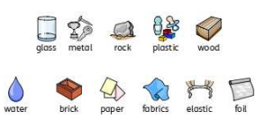
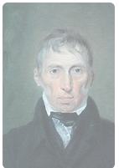



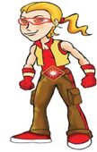
Year 2 Autumn term 1
Properties of everyday materials
Vocabulary
Properties
Strong
Transparent
Opaque
Rigid
Flexible
Recyclable
Stretch
Twist
Squash
Bend
Manmade
Natural
Waterproof
Absorbent
Suitable
Unsuitable
Overview
Scientist studied
John Loudon McAdam
Building on from Year 1, the children will learn which materials are natural and which are manmade. They will identify the properties and suitability of materials for different purposes. They will understand that a material is used for a purpose because of its properties, eg glass can be used for a window.
Children will learn about recycling and the recycling process. They will find out about the inventor John Loudon McAdam who developed tarmac road surfaces.
Key Questions
How can you change the shape of a material?
Are all spoons made of the same material?
Why is a chair made out of wood?
Why is recycling important?

Slide 3
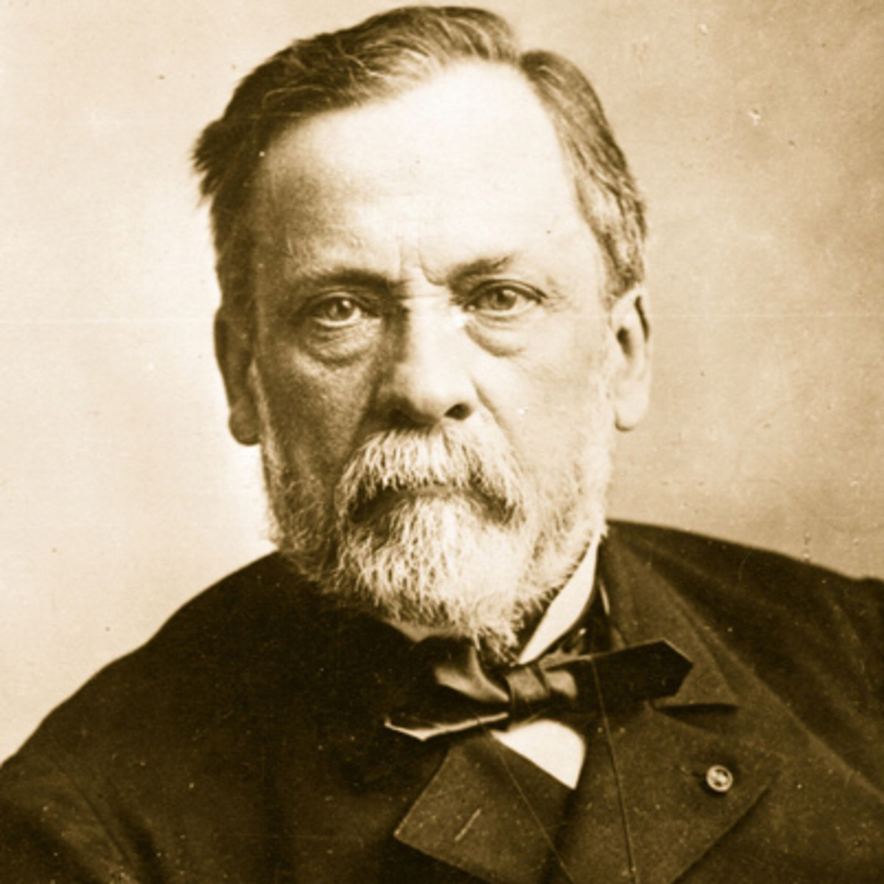


Year 2 Autumn Term 2/Spring term 1 Animals Including Humans
Key Vocabulary
Offspring
Life Cycle
Adult
Egg
Spawn
Pregnancy
Chick
Hatchling
Tadpole
Baby
Toddler
Teenager
Basic Needs
Diet
Hygiene
Exercise
Germs
Scientists Studied
Louis Pasteur
Overview
The children will learn that animals and humans have offspring which grow into adults. They will investigate what we need to survive and be healthy. The children will learn about the basic needs that are shared by humans and animals. They will explore the need for humans to eat a varied diet, to keep themselves clean, and to take regular exercise.
Louis Pasteur
Key Questions
How does a tadpole change over time?
Which offspring belongs to which animal?
Which age group of children wash their hands the most in the day?
What do you need to do to look after a pet dog and keep it healthy?
Enquiry Skills Covered
Identifying and Classifying Observing Over Time Fair testing Pattern Seeking

Slide 4
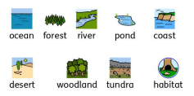


Year 2 Spring Term
Living Things and
Their Habitats
Key Vocabulary
Living
Non Living
Dead
Habitat
Food Chain
Herbivore
Carnivore
Omnivore
Consumer
Producer
Predator
Prey
Micro – habitat
Desert
Woodland
Rainforest
Arctic
Overview
The children will learn about a variety of habitats and the plants and animals that live there. They will learn to tell the difference between things that are living, dead and things that have never been alive. The children will make observations of habitats around them including micro. They will learn how animals obtain food and what a food chain is.
Key Questions
How does the cycle path change over the year?
Which habitat do worms prefer – where can we find the most worms?
How does a cactus survive in a desert with no water?
How would you survive in a rainforest?
Enquiry Skills Covered
Researching Using Secondary Sources Pattern Seeking Identifying and Classifying

Slide 5
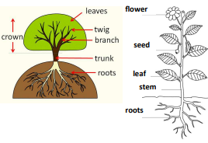
Year 2 Summer Term
Plants
Key Vocabulary
Roots
Stem
Seed
Bulb
Leaf
Flower
Germinate
Life Process
Water
Light
Temperature
Dispersal
Compost
Fruit
Properties
Overview
The children will closely study plants and trees in the natural environment. They will plant a seed and a bulb and compare them as they grow. The children will set up an experiment to observe what plants need to grow well, and watch the germination process first hand by growing cress.
Children will create a bar chart to show how tall plants have grown to the nearest cm.
Key Questions
Do bigger seeds grow into bigger plants?
What happens to my bean after I have planted it?
Do cress seeds grow quicker inside or outside?
Enquiry Skills Covered
Comparative and Fair Testing Observing Over Time Pattern Seeking

Slide 6
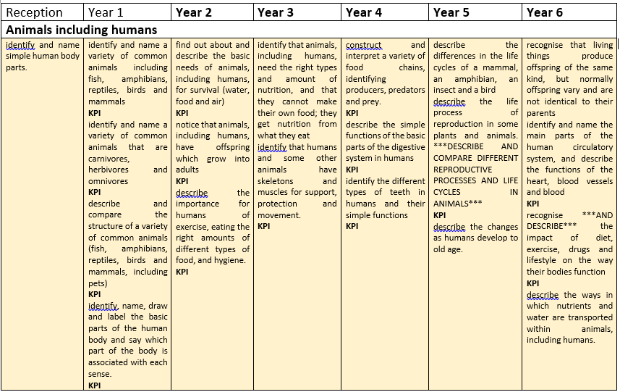
consider similarities and differences between themselves and others. explore what they can do with different body parts. Recognise the 5 senses and use their senses to learn about the world around them.
think about how they have changed and how to keep themselves healthy and safe.

Slide 7
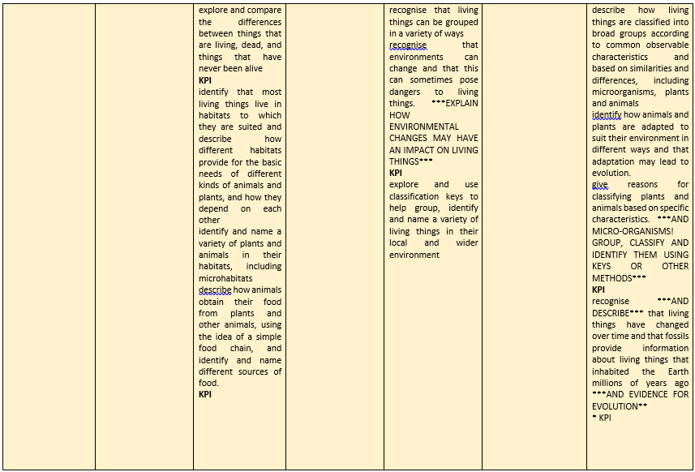
begin to identify and name a range of common minibeasts.
talk about similarities and differences in body parts, patterns etc. observe the life cycle of a butterfly.
observe and discuss the changes at different stages of the life cycle.

Slide 8
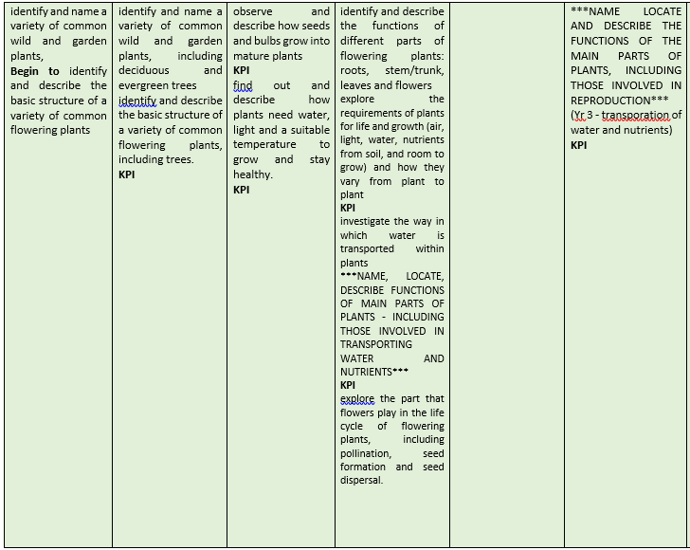
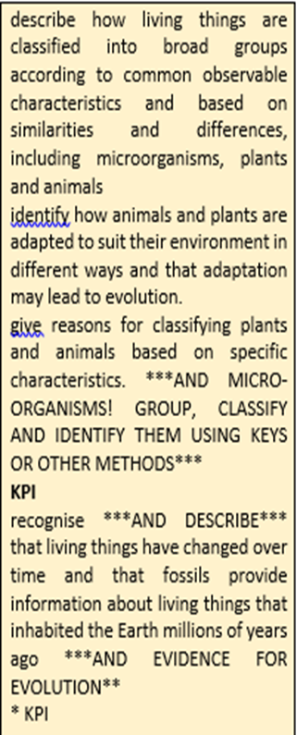

Slide 9
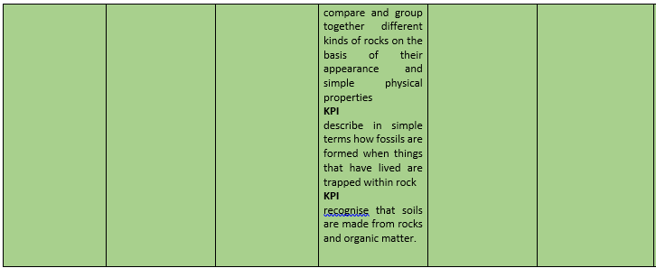
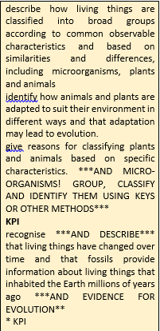

Slide 10
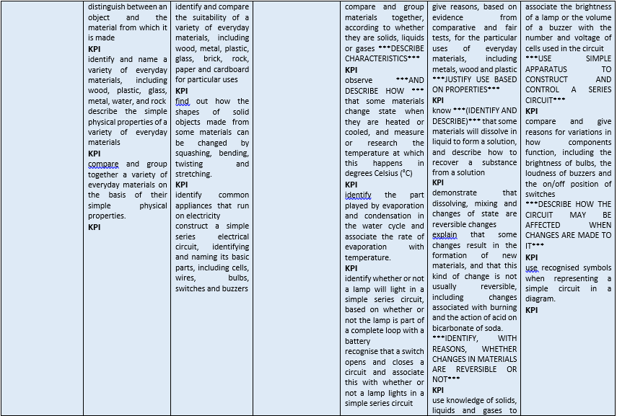
identify and name some materials use knowledge of textures to describe materials. explore straw, wood and brick and consider strength and suitability.

Slide 11
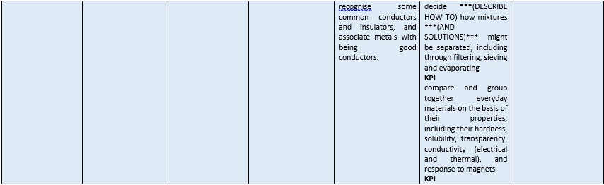

Slide 12
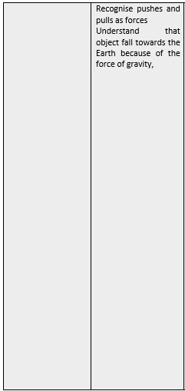
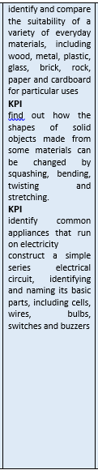
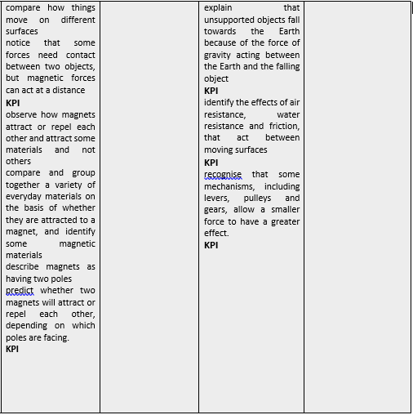

Slide 13
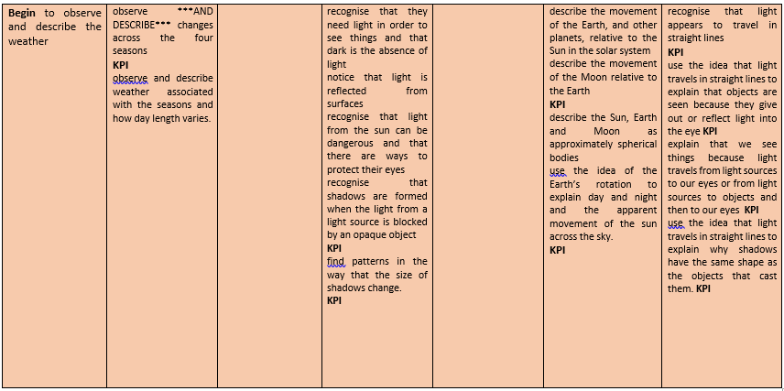
Begin to recognise and describe weather associated with the seasons.

Slide 14
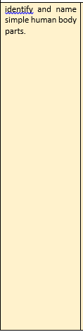
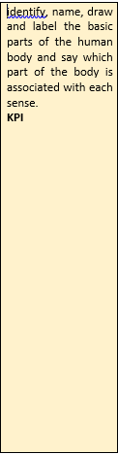
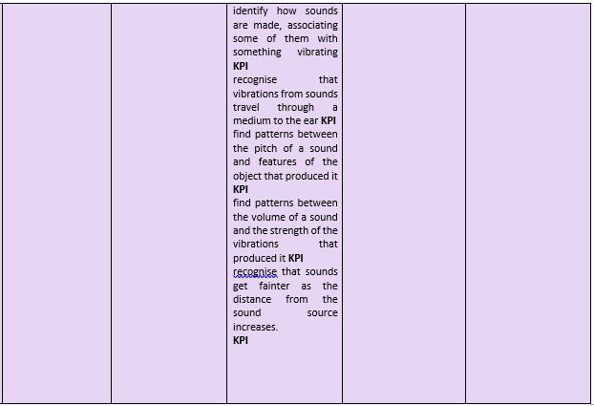
Recognise the 5 senses and use their senses to learn about the world around them

