Slide 1
HISTORY
Knowledge organisers

Slide 2

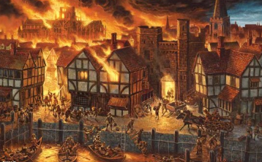

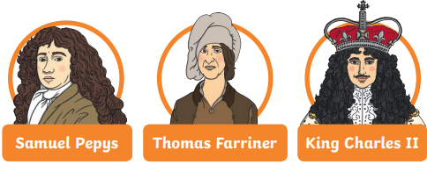
Year 2 The Great Fire of London
Key Vocabulary
Capital City
Bakery
Diary
Firebreak
Fire squirt
Leather water bucket
Fire hook
Axe
Act of Parliament
Monument
Homeless
Destroyed
Overview
London is the Capital of England
The Location of London on a map
When and where the fire started
Why the fire spread so quickly
How people worked together to stop the fire
That King Charles and his men succeeded in putting it out by blowing up buildings
How London changed after the fire
How firefighters now differ to then
Understand that The Great Fire happened so long ago that no-one is still alive from that time
Historical Skills
Sequence events in chronological order
Give reasons for why the fire spread so far
Compare firefighting then and now
Identify how London has changed and explain why
Name the key (significant) people involved in the Great Fire and say what their roles were
Evaluate sources of evidence about the fire. Say which are the most useful and give reasons
Key People

Slide 3

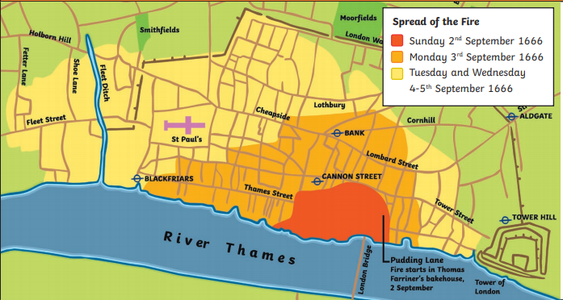
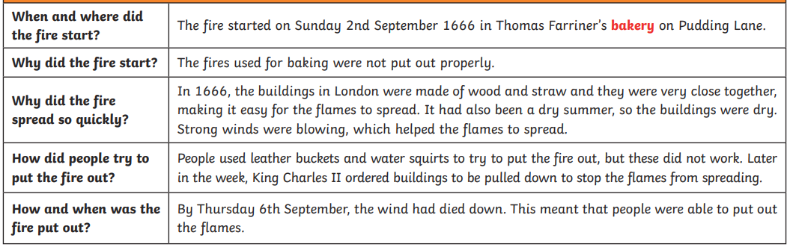
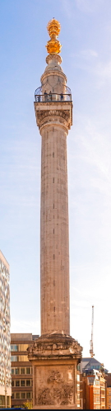
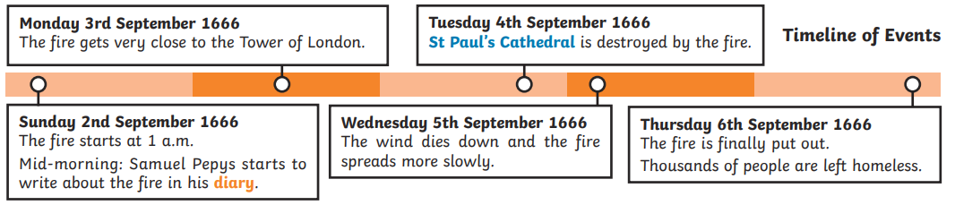
Year 2 The Great Fire of London
Map of the Fire
Key events and Facts
Key events and Facts

Slide 4
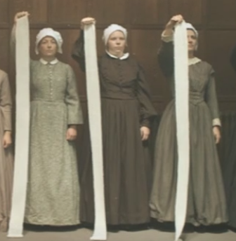
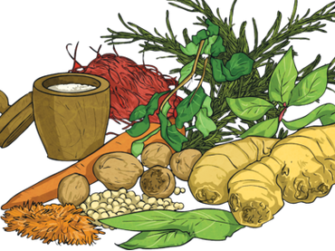
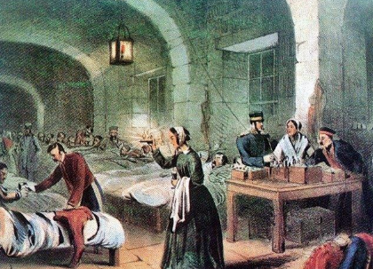
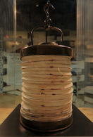
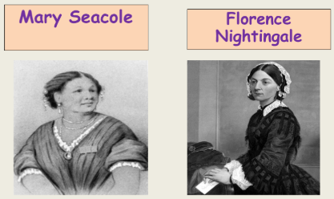
Year 2 Nurturing Nurses
Key Vocabulary
Nurse
Hospital
Casualty
Crimea
Scutari
War
battlefield
Soldier
Ginger
Lamp
Bandages
Pioneer
Herbal remedies
Jamaica
Prejudice
Society
Training
Stench
Overview
Florence Nightingale and Mary Seacole were nurses during the Crimaean war
Both women faced challenges in becoming nurses from their families and other people at the time
The hospital Florence worked in was in Scutari, Turkey
The hospital was disgusting. The soldiers were dyeing because it was so dirty and they were not being well looked after
Both Florence and Mary made big changes in the hospitals and are still remembered today because of what they did
Florence set up her own nursing school when she returned to London
Key People
Historical Skills
Sequence events in chronological order
Compare nursing and hospitals then and now
Explain the impact of the changes
Find similarities and differences between Florence and Mary
Evaluate sources of evidence about the war and the nurses. Say which are the most useful and give reasons.

Slide 5
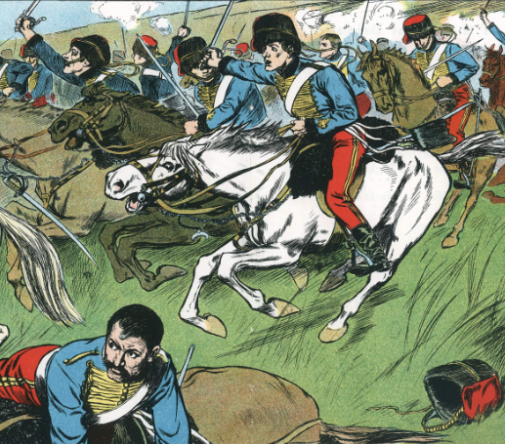

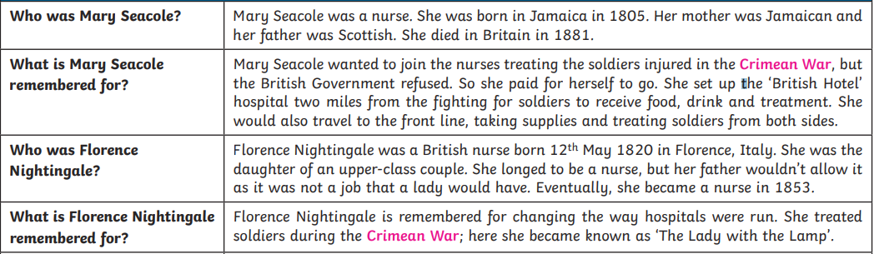
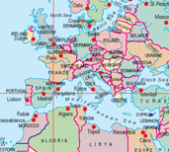
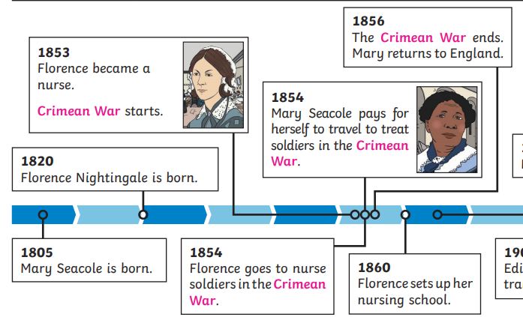
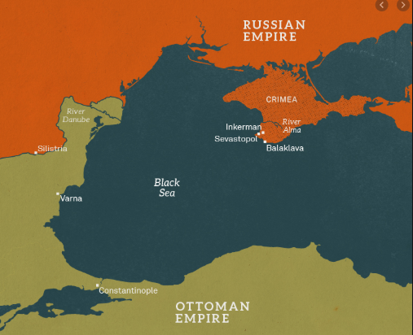
Year 2 Nurturing Nurses

