Slide 1
GEOGRAPHY
Knowledge organisers

Slide 2
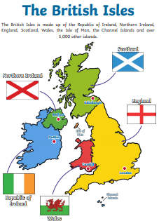
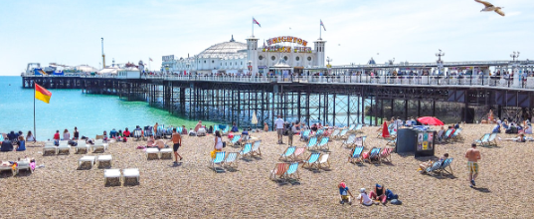
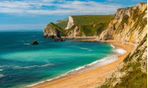
Year 2 Spring Term
Beaches
Geographical skills
Use maps and atlases to find and label the continents and oceans of the world
Use atlases and maps to find and label the countries, capital cities and seas of the UK
Describe each part of the beach and what people use them for
Identify which parts of the beach are human and physical geography
Place Knowledge
Know that beaches are found on the coast – the edge of the land before the sea
Know what a beach is and what we use them for
Identify the key features – the sand dunes, cliffs, pier, harbour and bay
Locational Knowledge
Name the 4 countries of the UK and their position on a map
Name the capital cities of the UK
Name the seas surrounding the UK
Name and describe the parts of a beach
Know what people use each part of the beach for
Know which parts are man-made and which are natural

Slide 3

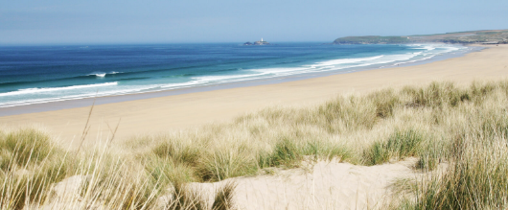
Year 2 Spring Term
Beaches
Physical Geography
UK
The names and locations of the 4 countries of the UK
The names of the Capital Cities in the UK
The names and locations of some of the larger seaside towns in the UK
Name the seas surrounding the UK
Beaches
On images of beaches, locate cliffs, sand dunes, bay and coast
Describe the main features of each of these parts of the beach
Human Geography
Beaches
On images of beaches, locate the pier, harbour, port, promenade and lighthouse
Describe the main features of each of these parts of the beach
Understand what each of these man-made parts of the beach are used for why they were built
Understand why people visit the beach and how tourism impacts on the beach and the people who live in the seaside towns
Vocabulary
Beach
Pier
Cliff
Bay
Harbour
Port
Sand dunes
Sand
Pebbles
Promenade
Beach hut
Lighthouse
Coast
Capital City
UK
England
Wales
Scotland
Northern Ireland

Slide 4
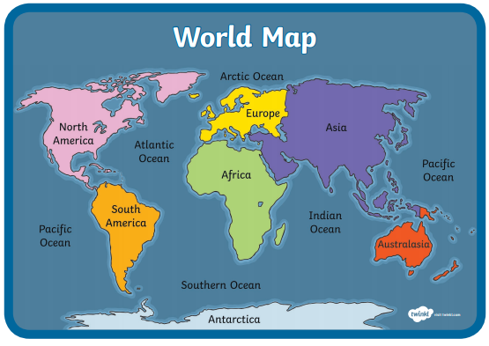
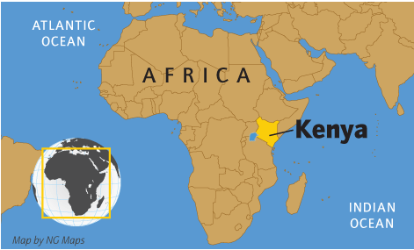
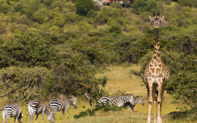
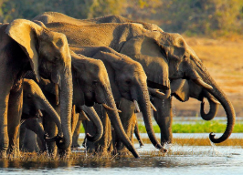

Year 2 Summer Term
Kenyan Safari
Geographical skills
Use maps and atlases to find and label the continents and oceans of the world
Use atlases and maps to find and label main arts of Kenya
Describe what Kenyan villages are like and compare them to a UK area (Yeadon)
Use compass directions to describe the location of places in Africa
Place Knowledge
Know some facts about the Masai people
Know how a Masai village is different to Yeadon
Know that Kenya is close to the equator and that this makes it very hot there
Lots of endangered animals live in Kenya – lions, elephants and giraffes
Locational Knowledge
Review the names the 4 countries of the UK and their position on a map
Review the names and locations of the continents and oceans
Know that Kenya is an African country
Know how we could get to Kenya, including compass directions

