Slide 1
Art and Design:
Year 2
Knowledge organisers

Slide 2
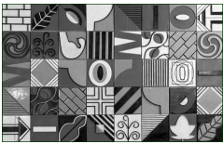
Art and Design Year 2:
Drawing
Artist studied
Nancy McCroskey
Prior Learning
Children have used pencils to draw lines of varying thickness and shape. They have used observation and own ideas for drawing.
Exploring and Developing Ideas: Look, Talk , Sketch
Use sketchbooks to develop and explore ideas and experiences.
Key Learning
Children build on and develop different techniques involved in drawing such as tone, pattern and shape as well as using different surfaces to draw on. Children are also exposed to using different materials to draw with such as pencils, felt tips, charcoal, crayons, chalk and pastels.
Y2 Cross Curricular Links:
History – Great fire of London
Science – Materials/Animals including humans
Activities, Artists and Links
Autumn
Shading – Nancy McCrosky
Sketching – Great fire of London – David Best
Spring
Sketching human form – Henry Moore
Summer
Drawing – oil pastels – African art EMEKA
Evaluating and Developing Work
Be able to talk about own and others work.
Be able to listen to other peoples views about artwork.
Be able to express and share an opinion about the artwork.
Take photos of own work as a record.
Key Skills
Use lines and shading to create pattern and texture
Use different materials to draw, for example pastels, chalk, felt tips, charcoal
Draw from different starting points including close looking via observation from primary & secondary source material
Draw from memory and imagination.
Knowledge and Understanding
Be able to name and identify the techniques they have used in the drawing process.
Key Vocabulary
Line, thin, thick, straight, curved, smudge, shade, tone, light, dark, space, form, hollow spaces, landscape.

Slide 3
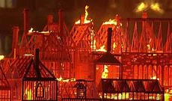
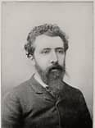


Art and Design Year 2:
Painting
Exploring and Developing Ideas: Look, Talk , Sketch
Use drawing, including the use of sketchbooks, to develop and share their ideas, experiences and imagination.
Prior Learning
Children have learned about primary and secondary colours. They are able to mix colours. They can use a range of brushes as they paint.
Artists studied
Georges Seurat
David Best
Key Learning
Children will continue to use a variety of tools and techniques. They will learn how to change colours by creating shades and tints. They will further explore colour, texture and scale.
Evaluating and Developing Work
Be able to talk about own and others work.
Be able to listen to other peoples views about artwork.
Be able to express and share an opinion about the artwork. Begin to make improvements to their work based on feedback from others
Y2 Cross Curricular Links:
History – Great fire of London
Geography - beaches
Key Skills
Name different types of paint and their properties
Add white and black to create tints and shades
Mix a range of secondary colours
Experiment with tools and techniques, including layering, mixing media, scraping through etc.
Mix and match colours to artefacts and objects
Use different sized brushes to create different effects.
Key Vocabulary
primary colours, secondary colours, tints, shades, tones, warm colours, cool colours, watercolour wash, sweep, dab, bold brushstroke, textures,
Pointillism
Knowledge and Understanding
Be able to name and identify the techniques they have used in the painting process.

Slide 4
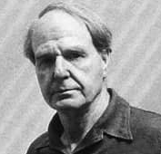
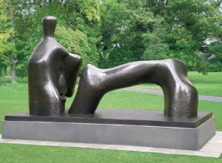
Art and Design Year 2:
Sculpture
Exploring and Developing Ideas: Look, Talk ,Explore, Sketch
Use discussion, practical exploration and sketchbooks, to develop and share their ideas, experiences and imagination.
Prior Learning
Children have learned to use basic tools and techniques, particularly when working with clay.
Key Learning
Children have the opportunity to use a variety of materials for sculpting and experiment with joining and constructing. They begin to use the correct vocabulary associated with sculpting and construction to demonstrate their understanding of the skill.
Evaluating and Developing Work
Be able to talk about own and others work.
Be able to listen to other peoples views about artwork.
Be able to express and share an opinion about the artwork.
Take photos of own work as a record.
Artists studied
Henry Moore
Key Skills
Experiment with, construct and join recycled, natural and man-made materials more confidently.
Explore modelling materials such as clay Explore, discover and invent ways for 2d to transform into 3d sculpture - through creating drawings or prints on paper, mould clay to create human form
Y2 Cross Curricular Links:
Science and PE
Key Vocabulary
sculpture, statue, model, work, work of art, 3D, sculptor, carve,
Bronze, stone hollow spaces, human form. landscape
Knowledge and Understanding
Understand the safety and basic care of materials and tools.

